Slide 1
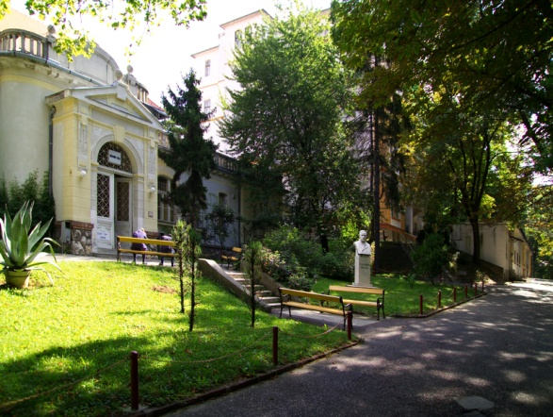
Research collaboration in CF:
Research activity in National Koranyi Institute
Balazs Antus
National Koranyi Institute of Pulmonology
Department of Pathophysiology
Pihenő út 1.
1121-Budapest
Hungary

Slide 2
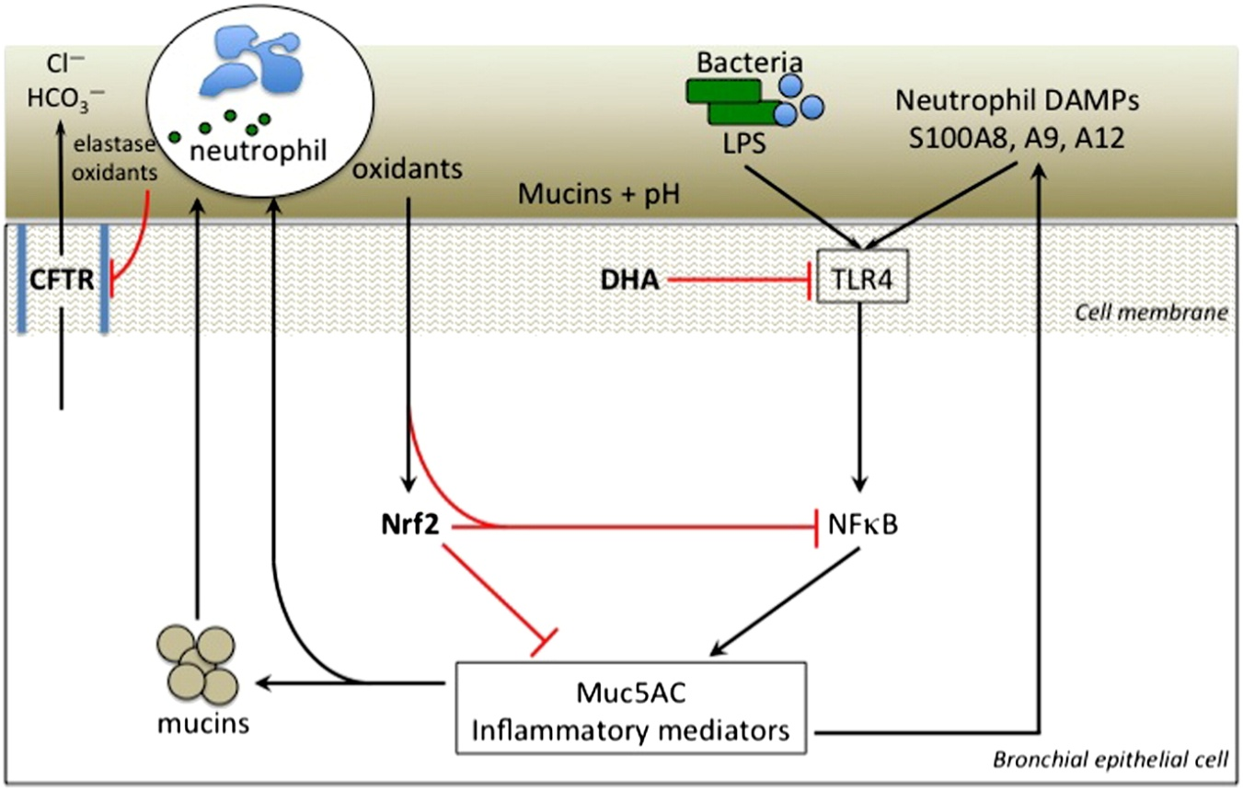
Chronic airway inflammation in CF
Mucus layer
Periciliary liquid layer (PCL)
Airway surface
liquid (ASL)
Loss of Cl⁻ and HCO₃⁻ secretion
ASL
dehydration
ASL
hypoxia
Immun dysfunctions:
NO synthesis ↓
NFκB activation
Nrf2 signaling ↓
Glutathione ↓
Neutrophil chemotaxis ↑
ASL pH ↓
„Sticky” mucin
Immune cell defects:
(due to CFTR deficiency)
Delayed phagocyta functions
Lipid abnormalities
(ceramide ↑, AA/DHA ↑)
Anti-bacterial defenses ↓
Neutrophilic airway inflammation
Cantin et al. J Cyst Fibros, 2015

Slide 3
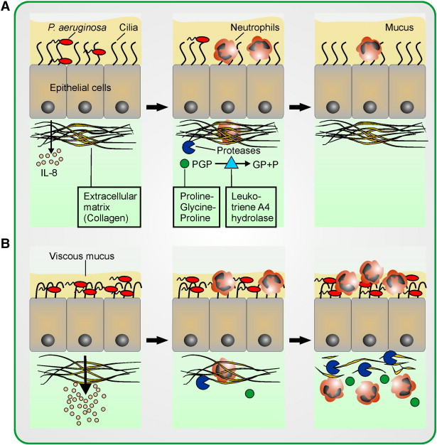
Oxidative stress in CF: role of neutrophils
NEUTROPHIL GRANULOCYTES
ROS and RNI (O₂•, OH•, NO•)
Serine proteases (neutrophil elasate, cathepsin G and S, proteinase-3, neutrophil serine protease-4, prolil endopeptidase)
Matrix metalloporteinases (MMP-8, MMP-9, MMP-12)
Calgranulins (S100A, S100A9, S100A12)
Citokines/chemokines (IL-1β, IL-6, IL-8/CXCL8, TNF-α, MCP-1, IP-10, RANTES, etc.)
Oxidative stress
ROS: reactive oxigen species
RNI: reactive nitrogen intermediers
PGP: proline-glycine-proline
Hartl et al. J Cyst Fibros, 2012

Slide 4
How to measure airway inflammation and oxidative stress?
chest X-ray, CT, MR
routine laboratory chemistry
blood gases
spirometry
plethysmography
…
Not useful
Exhaled breath
condensate (EBC)
Blood
Exhaled
breath
Sputum
Systemic
biomarkers
Pulmonary biomarkers

Slide 5
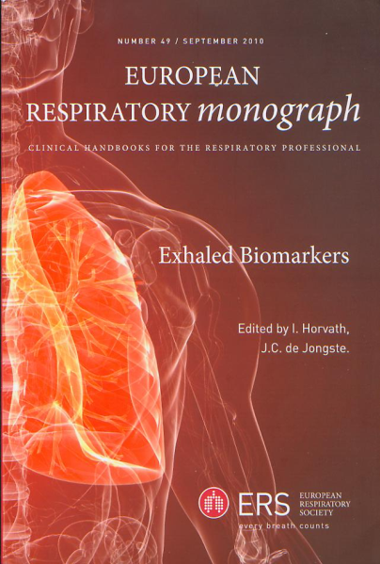

Pulmonary biomarkers
Exhaled gases | Exhaled breath condensate (EBC) | Induced sputum (IS)
Nitric oxide (NO) | cytokines and chemokines (IL-1β, IL-6, IL-10, TNF-α, MCP-1, MIP-1α, INF-γ, etc.)
carbon monoxide (CO) | leukotrienes (LTB₄, LTC₄, LTD₄, LTE₄) prostaglandins (PGE₂, PGD₂)
ethane | 8-epi-prostaglandin F_{2α} (8-isoprostane)
pentane | hydrogen peroxide (H₂O₂)
 | nitrogen oxides (NO₂, NO₃), nitrosothiols, 3-nitrotyrosine
 | hexanal, heptanal, nonanal, malondialdehyde (MDA), 4-hydroxyhexenal (4-HHE), 4-hyroxynonenal (4-HNE), acrolein
 | endothelin-1
 | matrix metalloproteinases (MMP-9, MMP-12)
 | adenosin, ATP
 | pH | sputum „eosinophilia”

Slide 6
Comparison of sampling methods
Sample | Biomarker | Advantage | Disadvantage
Exhaled air | FENO CO | non-invasive simple inexpensive repeatable ”on-line” measurement | signal is small smoking is a confounding factor
 | ethane pentane | non-invasive | expensive requires advanced laboratory infrastructure
EBC | citokines, hexanal, heptanal, nonanal, MDA, 4-HHE, 4-HNE, acrolein, NO₂, NO₃, H₂O₂ 3-nitrotyrosine, LTB₄, PGE_{2,} cys-LT 8-isoprostane pH | non-invasive no effect on underlying disease process repeatable ”on-line” measurement§ simple and inexpensive$ | high variability poor reproducibility lack of standardization requires laboratory infrastructure smoking is often a confounding factor
Sputum | citokines hexanal, heptanal, nonanal, MDA, 4-HHE, 4-HNE, acrolein, LTB₄, PGE₂, cys-LT, 8-isoprostane | semi-invasive informative for airway inflammation inflammatory cell profile | can cause inflammation/bronchoconstriction# high variability (sputum cells) requires laboratory infrastructure smoking is often a confounding factor
$valid for pH measurement only
§for H₂O₂ measurement
#when sputum is obtained by induction
Antus et al. Curr Med Chem, 2015

Slide 7
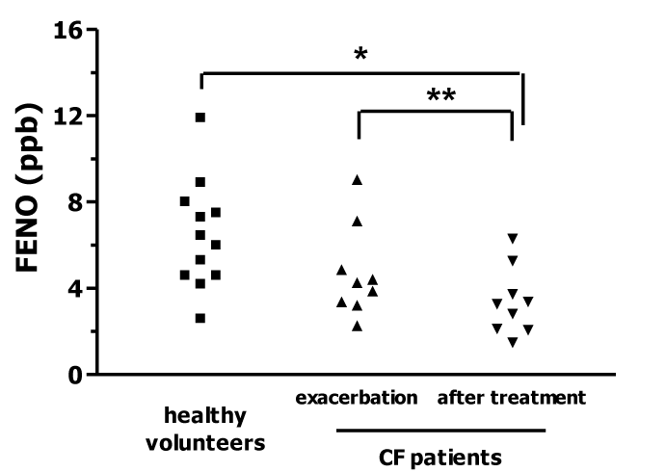
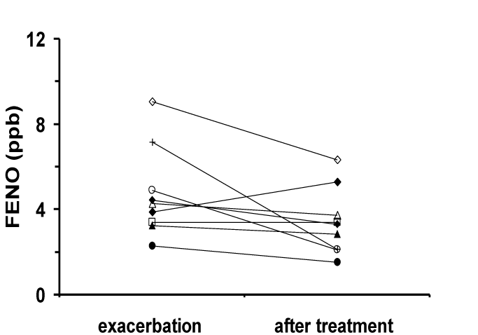
Fractional exhaled nitric oxide (FENO)
in CF exacerbation
*
*p<0.05 vs. CF patients with exacerbation
*p<0.01 vs. healthy controls, **p<0.05 vs. CF patients with exacerbation
Exacerbations are associated with increased FENO in CF patients, while treatment with antibiotics, bronchodilators and corticosteroids decreases FENO in these subjects. However, signals and changes are small.
Antus et al. Eur Respir J, 2004 (abstract)

Slide 8
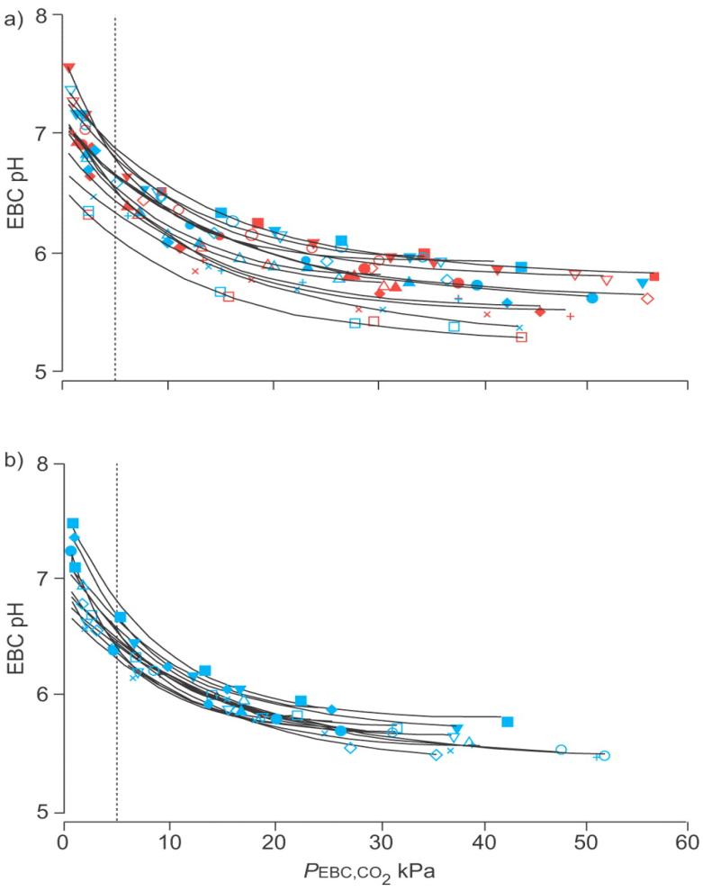
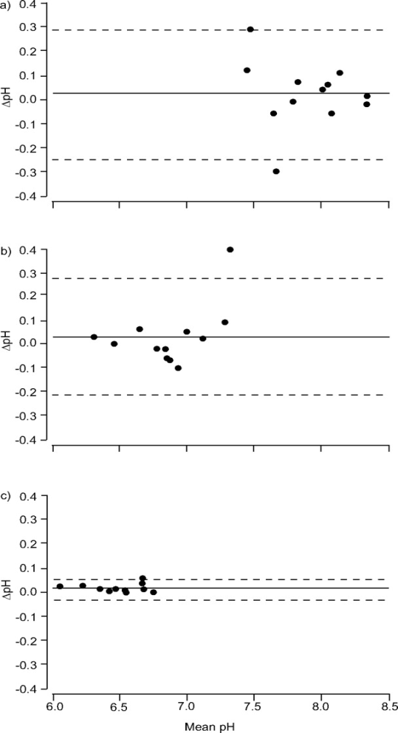
EBC pH: CO₂ gas standardization method
CO₂ → pH_{EBC} (CO₂ + H₂O ⇔ H₂CO₃ ⇔ H⁺ + HCO³⁻)
Repeatability
Protocols
Healthy subjects
Argon
bubbling
Without argon bubbling
(„raw”)
Asthmatics
CO₂ „loading”
PaCO₂=5.33 kPa
Kullmann et al. Eur Respir J, 2007

Slide 9
Confounding factors in EBC pH assay
CO₂ and/or NH₃
Hunt et al. Am J Respir Crit Care Med, 2002
Vaughan et al. Eur Respir J, 2003
Effros et al. Am J Respir Crit Care Med, 2006
Kullmann et al. Eur Respir J, 2007
Type of condenser (EcoScreen, R-Tube, Anacon, etc.)
  Prieto et al. Respir Med, 2007
  Czebe et al. Respir Med, 2008
  Antus et al. Am J Respir Crit Care Med, 2010
Condensing and/or ambient temperature
  Czebe et al. Respir Med, 2008
  Koczulla et al. Respirology, 2010
Smoking
Hoffmeyer et al. J Physiol Pharmacol, 2009
Koczulla et al. Respiration, 2010
Antus et al. Am J Respir Crit Care Med, 2010
Relative humidity of ambient air
Kullmann et al. Eur Respir J, 2008
  Drinking
  Kullmann et al. Lung, 2008
Sample storage (-70°C)
  Vaughan et al. Eur Respir J, 2003
  Kullmann et al. Respir Med, 2007
Salivary contamination
  Wells et al. Thorax, 2005
  Effros et al. Am J Respir Crit Care Med, 2006
  Lazar et al. Inflamm Res, 2008
  Antus et al. Am J Respir Crit Care Med, 2010
  Antus et al. Inflamm Res, 2012
Yes
No / Uncertain

Slide 10
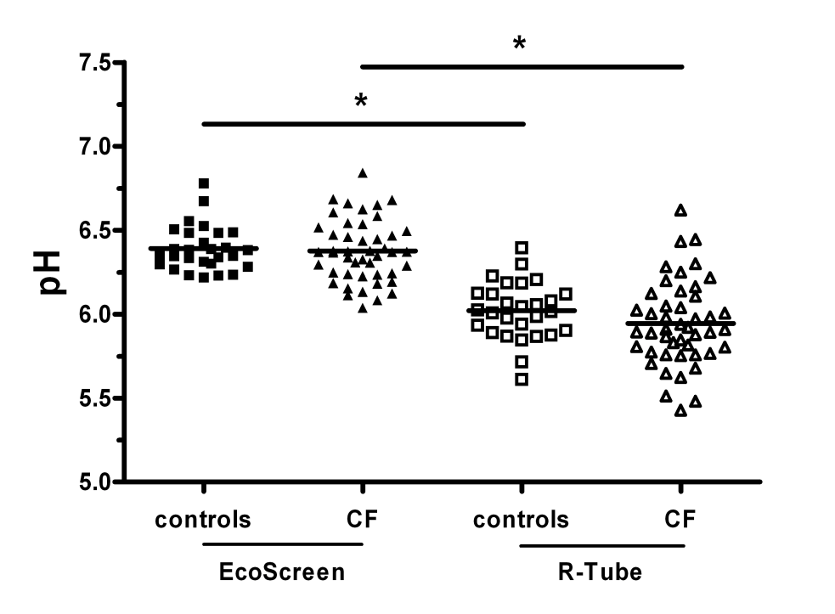
EBC pH in stable CF
EBC pH in CF patients and healthy controls were similar, while the type of the condenser influenced pH readings.
Antus et al. Inflamm Res, 2012

Slide 11
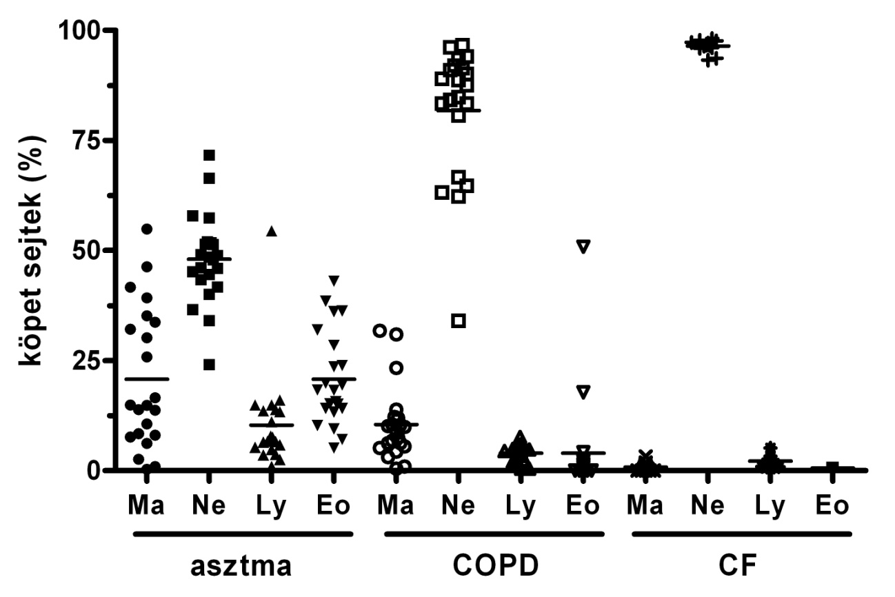
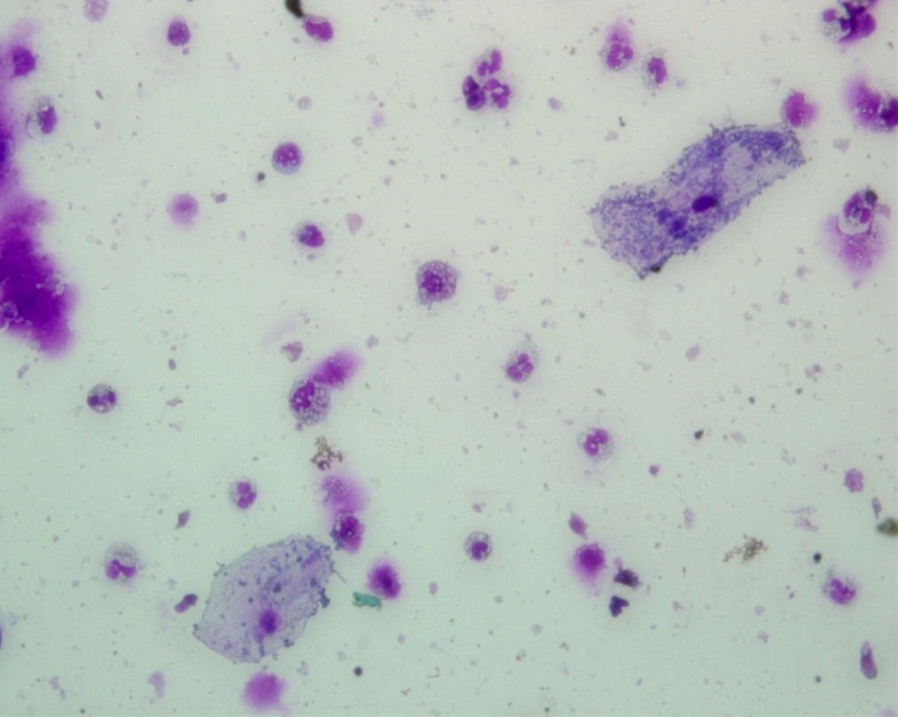
Sputum inflammatory cell profile
Macrophages
Neutrophil
granulocytes
Ma: macrophages
Ne: neutrophils
Ly: lymphocytes
Eo: eosinophils
In CF patients ∼90-95% of sputum inflammatory cells are neutrophil granulocytes, and the total sputum cell count is ∼10-times higher than in asthma or COPD (∼10⁷ vs. 10⁶ cells/gramm sputum).
Antus B. Orv Hetil, 2012

Slide 12
Malondialdehyde (MDA):
biomarker of oxidative stress

Slide 13
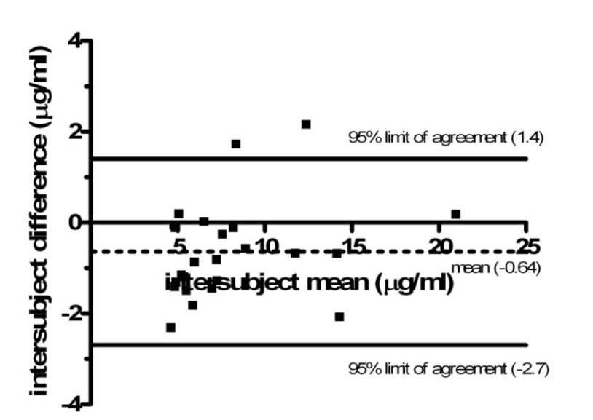
Measurement of MDA
in the airways using HPLC
MDA
High performance liquid chromatography (HPLC)
Sputum
MDA can be very precisely measured in respiratory samples (sputum, EBC, lavage) using HPLC, the measurement has a good repeatability.
Antus et al. Respirology, 2014

Slide 14
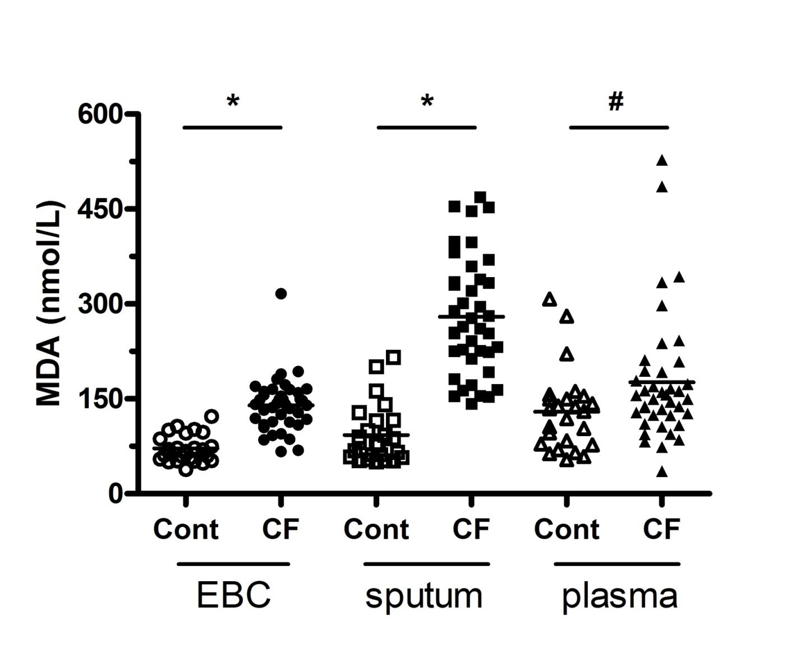
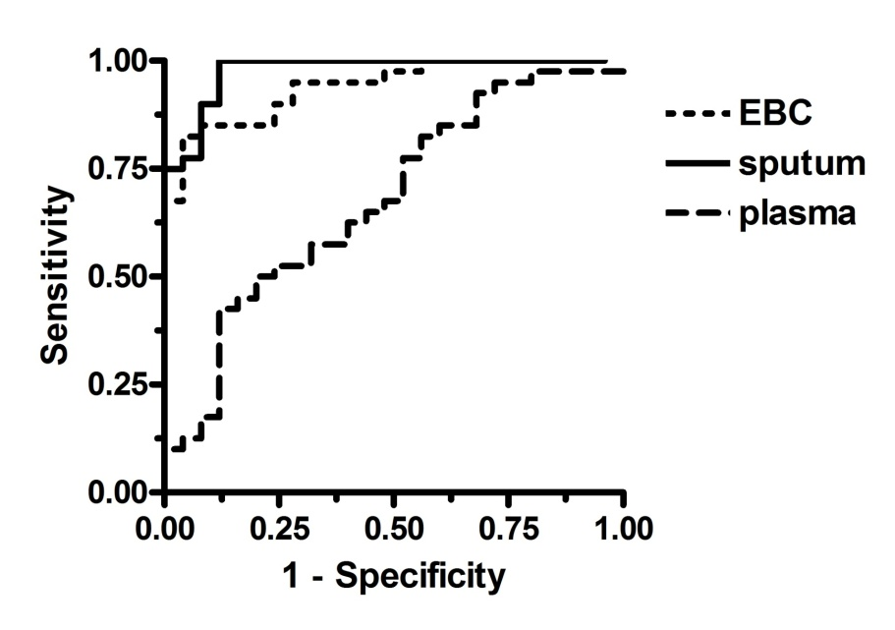
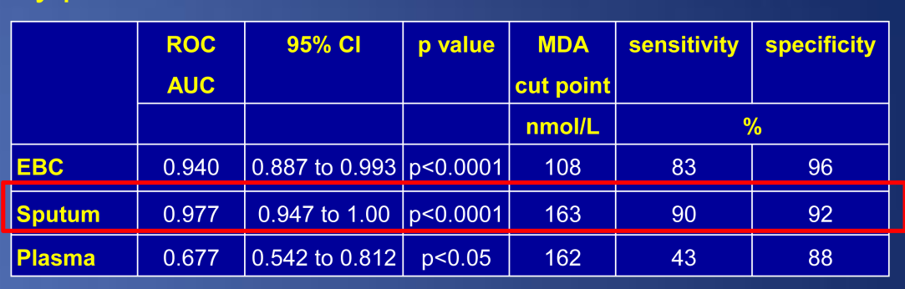
MDA in stable CF
Discriminatory power of MDA measurement
*p<0.0001 and #p<0.05 vs. healthy controls
MDA levels in sputum, EBC and plasma were increased in patients with CF compared to healthy controls.
Sputum MDA can differentiate best between patients and healthy controls.
Antus et al. Lung, 2015

Slide 15
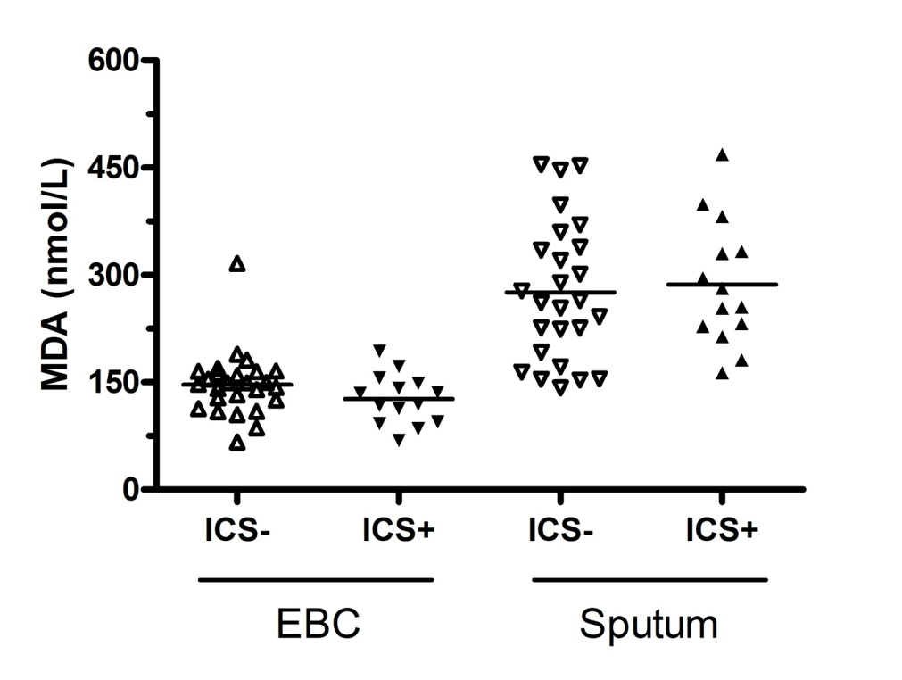
Inhaled corticosteroid (ICS) treatment
Regular ICS treatment
Regular ICS treatment had no effect on MDA levels in CF patients.
Antus et al. Lung, 2015

Slide 16
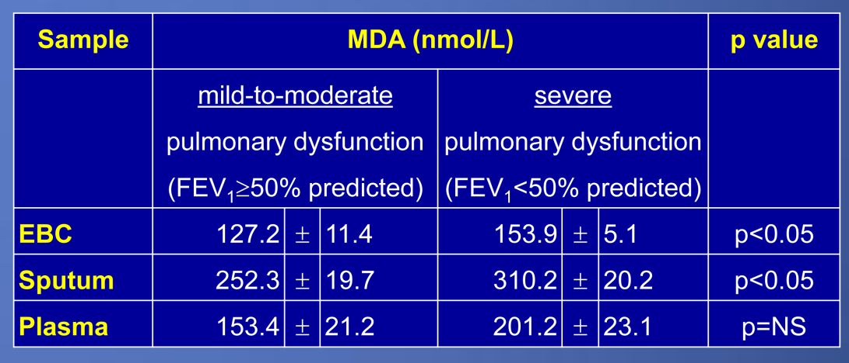
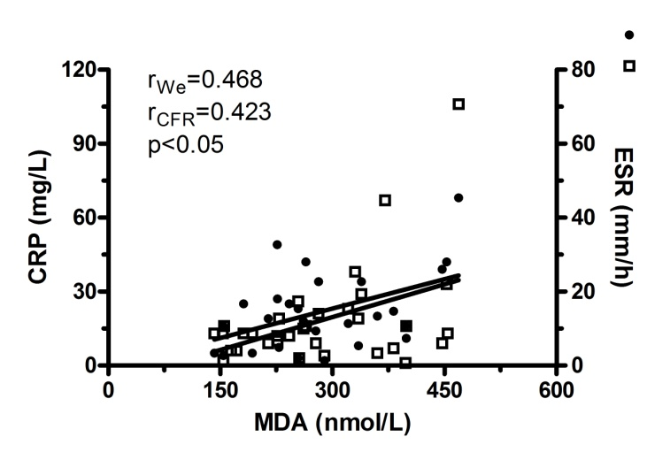
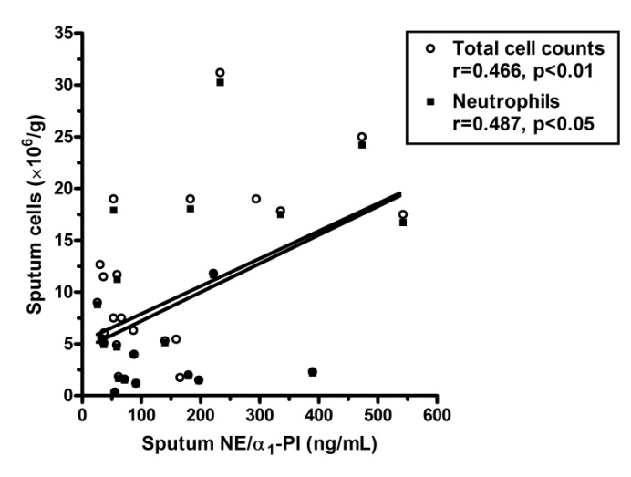
MDA in CF patients with different pulmonary dysfunction
Patients with more impaired pulmonary function had elevated levels of MDA in sputum and EBC, but not plasma.
CRP and ESR
NE/α₁-proteinase inhibitor
MDA is a potential new airway marker of oxidative stress in CF.
Antus et al. Lung, 2015

Slide 17
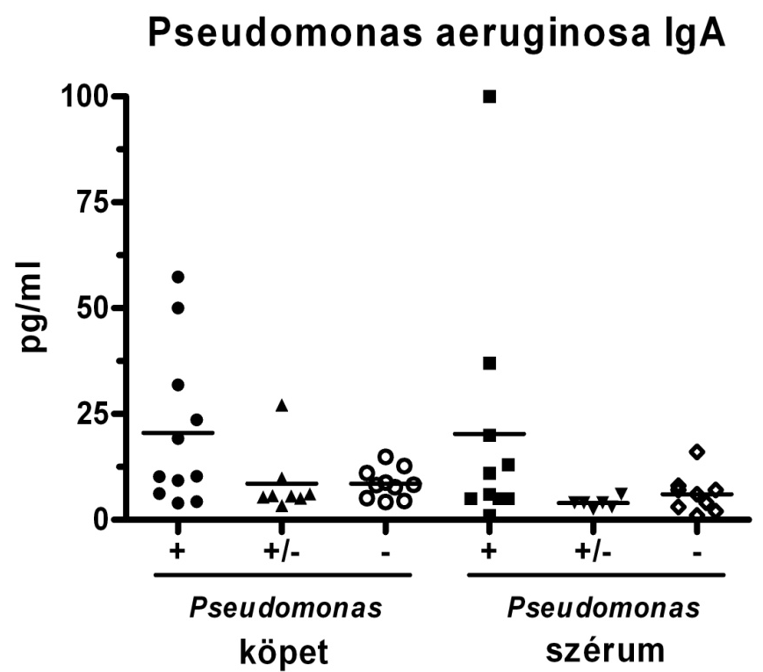
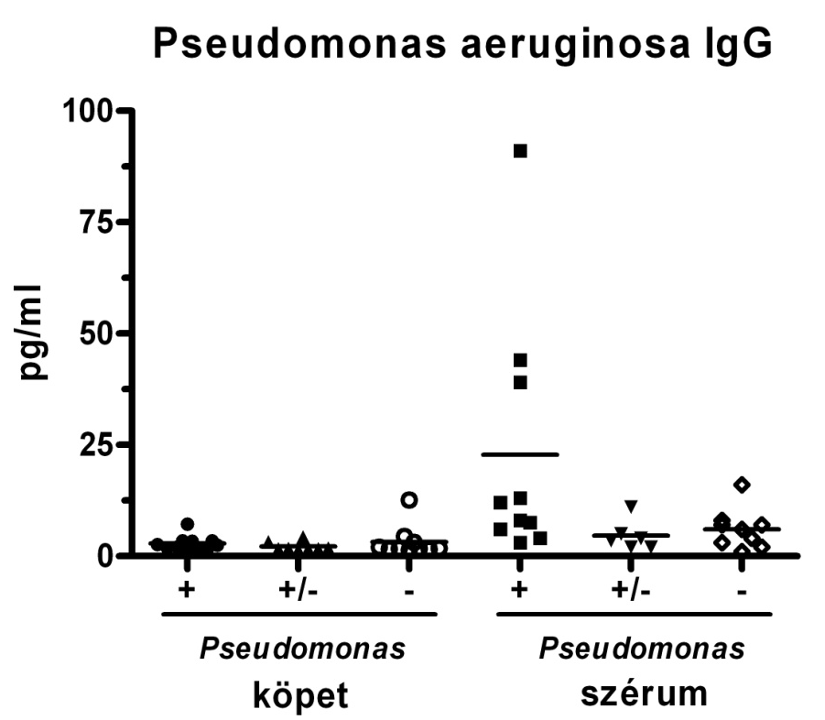
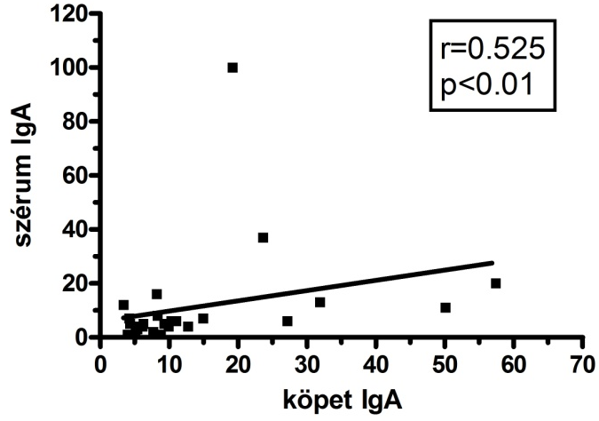
Detection of anti-Pa antibodies in
sputum of CF patients: a pilot study
Sputum
Serum
Sputum
Serum
Sputum anti-Pa IgA antibody levels are elevated in patients with P. aeruginosa infection, and the sensitivity of the assay is even greater in sputum than in plasma raising the possibility that sputum could be material of choice for early detection of P. aeruginosa infection.
Serum IgA
Sputum IgA
Kelemen et al. Eur Respir J, 2012 (P1449, abstract)

Slide 18
Summary
There are several studies in our Institute investigating various molecules and cellular mediators as possible pulmonary biomarkers in CF patients.
Research in our Institute contributes to a better understanding of CF lung disease, and represents an important part of the mission of our Institute.

Slide 19





Thank you!
National Koranyi Institute of Pulmonology
Department of Pathophysiology
Dr. Imre Barta
Dr. Csilla Páska
Orsolya Drozdovszky
Mária Mikoss
Mária Hernádi
Department of Pathology
Gabriella Hárnási
Department of Pulmonology
Dr. Szabolcs Sótér
Dr. Krisztina Kelemen
Prof. Dr. Ildikó Horváth
Dr. Eszter Csiszér

